Slide 1
GUI-RITS(ver1.5.0) Rits user manual 05/28/2025
Change slide p6 for ver1.5.1, 2025/08/28

Slide 2
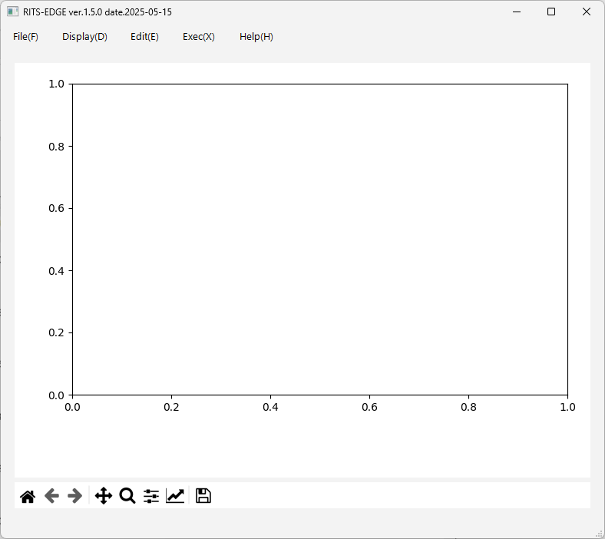
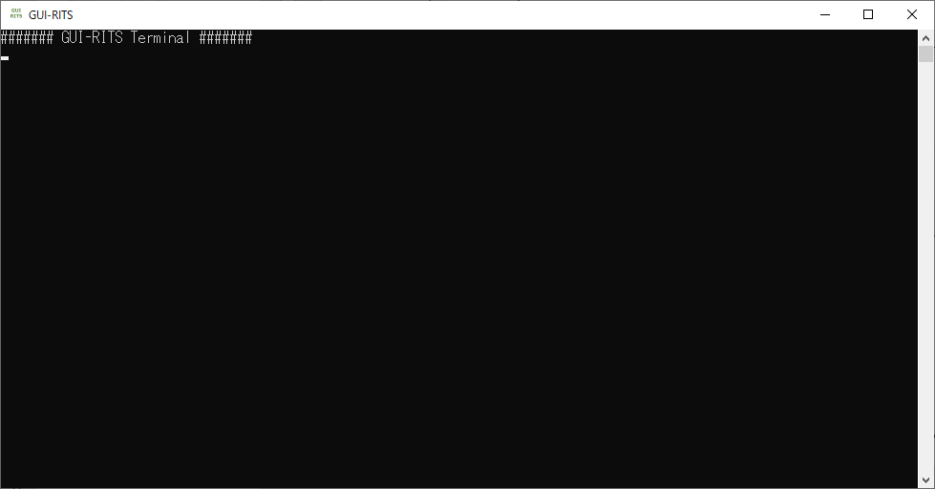
When GUI-RITS is launched in Windows, two windows like this one will appear unless you customize it.
In this manual, the lower left window is called the “terminal” and the upper right window is called the “main screen”.
The terminal has no control functions. It can be ‘hidden’ if it gets in the way. (Do not ‘close’.)
Main screen
Terminal

Slide 3
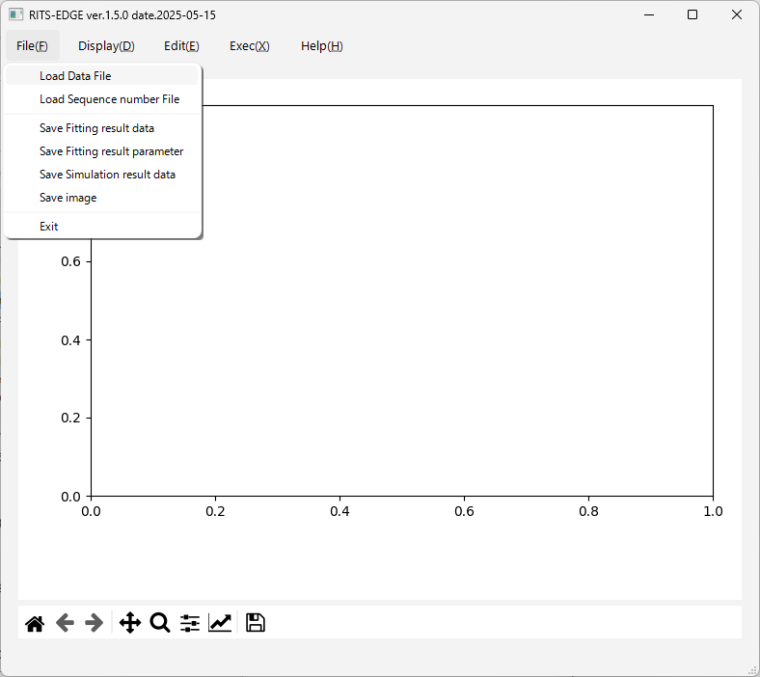

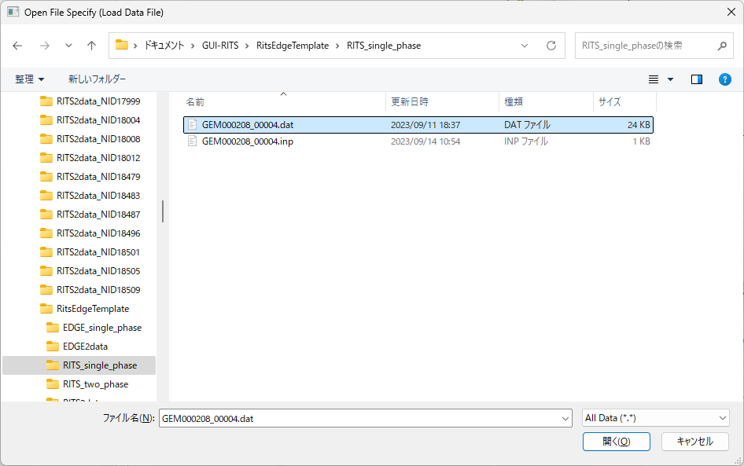
As a start, let's load a transmission data from the template folder ‘RITS_single_phase’.
Select "Load Data File" from the File menu.
The Windows Explorer screen will appear, and select the data file ‘GEM000208_00004.dat’.

Slide 4
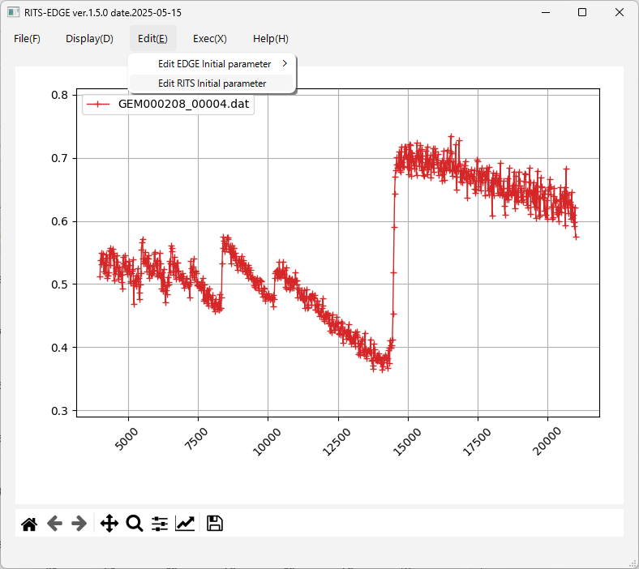
After loading the data file for a sample (in this example, GEM000208_00004.dat), the spectrum is displayed as shown in the main screen. The horizontal axis is tof (μs) and the vertical axis is transmittance.
The explanation of the Display(D) menu is omitted.
Next, select Edit RITS Initial parameter from the Edit menu.

Slide 5
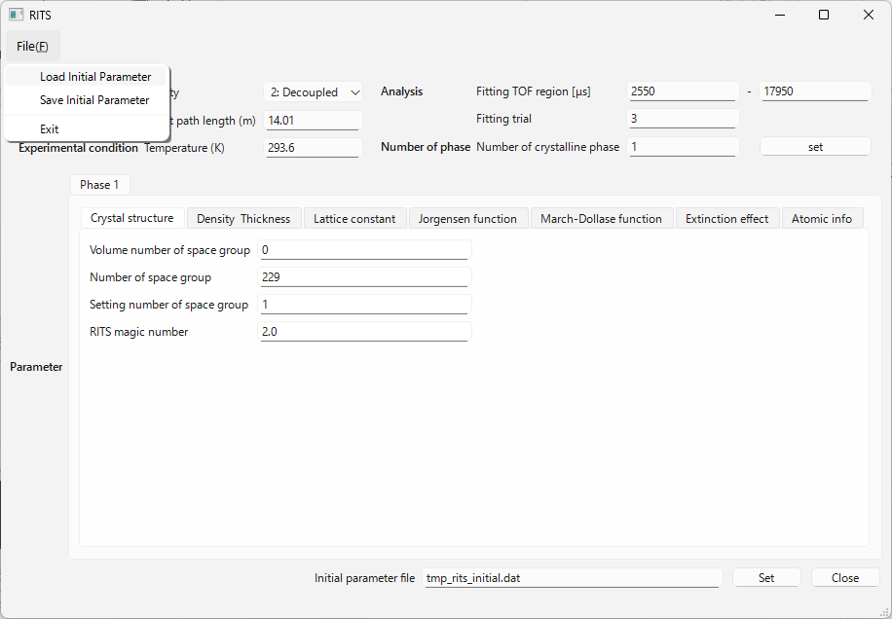
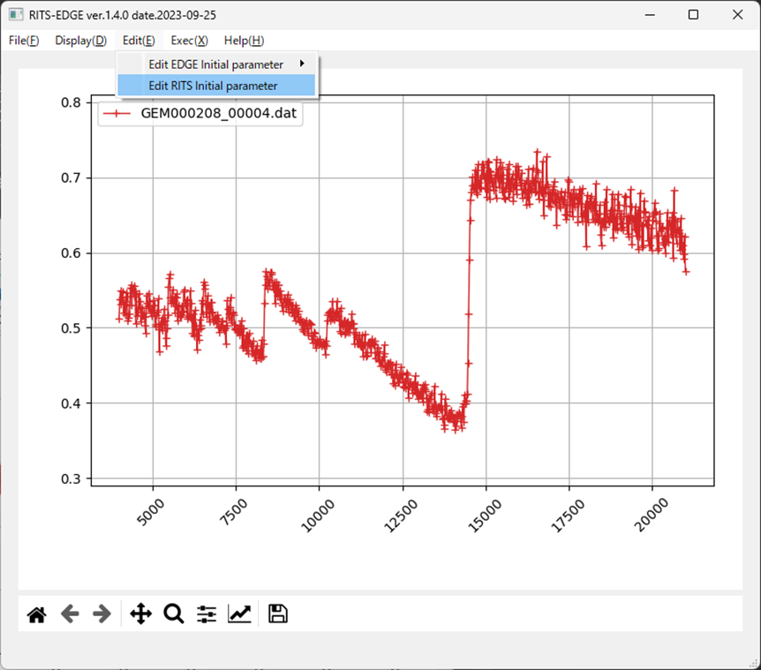
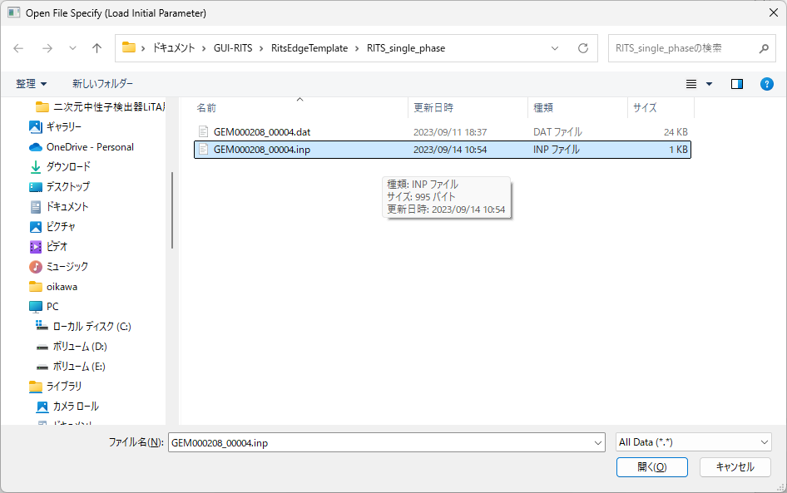
By selecting "Load Initial Parameter" from the File menu of the RITS panel, the Windows Explorer screen will appear.
Select the initial value file to read the values. (ex. GEM000208_00004.inp)

Slide 6
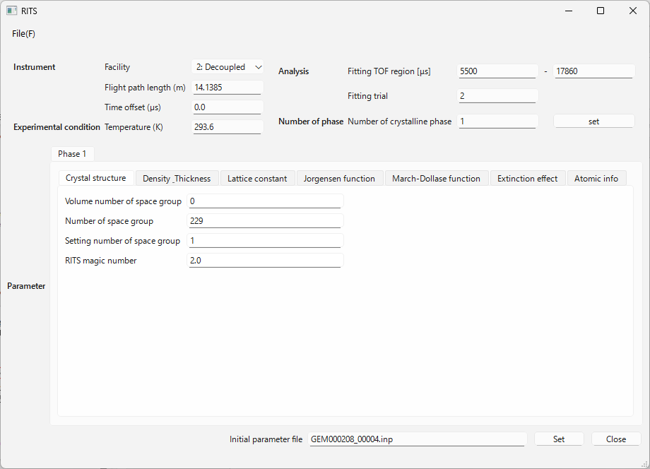
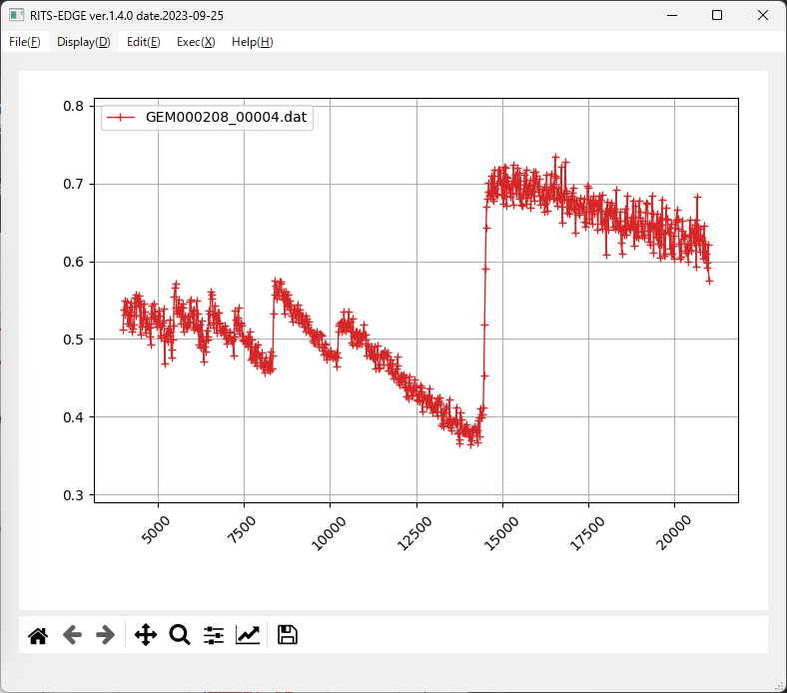
Analysis range.
I think more would only take more time.
1 for single phase, 2 for 2 phase.
Example of ‘14 m detector position’ of BL10
Leave it 0.
Space group number
Space group setting
Number of formula units (molecules) in the unit cell; Z-value
The Time offset (us). For J-PARC instruments, a default value of 0.0 is generally acceptable.
When the initial value file is read (GEM000208_00004.inp in this example), the values and the flags are entered.
“Crystal structure” Tab

Slide 7
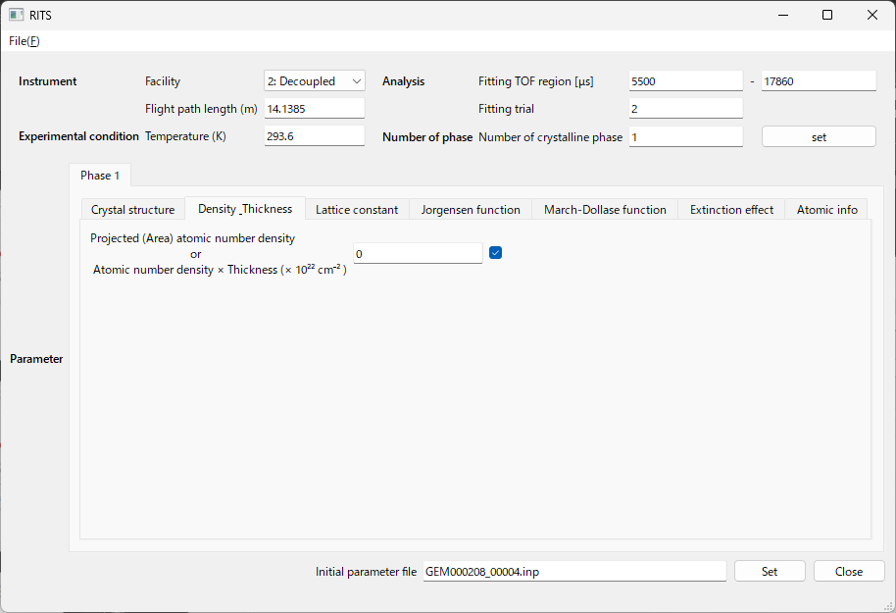

refinement flag
‘0’ means ‘auto guess value’ for the single-phase.
This option requires that the data be single-phase and that the transmission data contains less than 1.5 Å.
“Density_Thickness” Tab

Slide 8
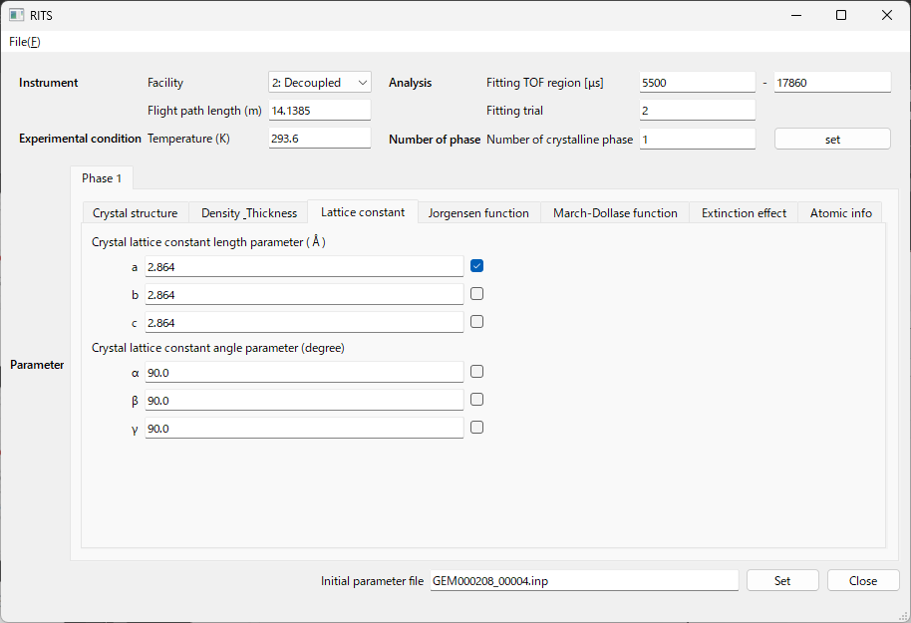

refinement flag
Initial values for lattice constants.
If a=b=c, put the same value.
“Lattice constant ” Tab

Slide 9
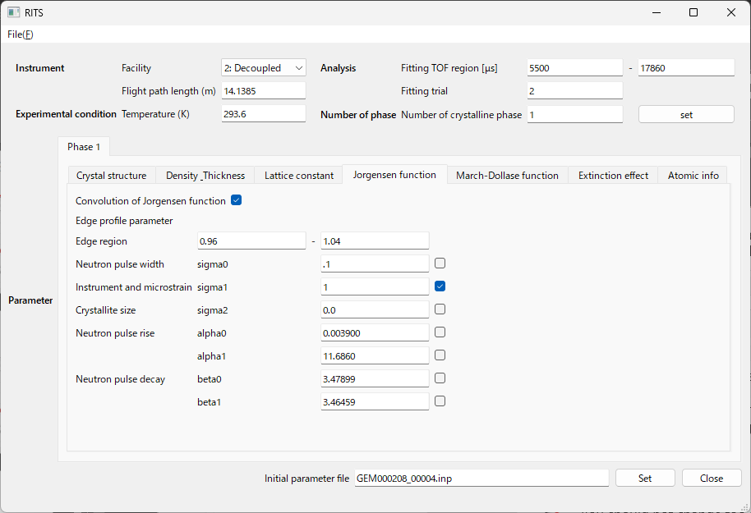

“Decoupled” has to be selected for BL10 and BL22 at J-PARC. If you make a mistake, the parameters will change by a factor of 10.
This is the only one that is not a flag for refinement. Basically on.
There is no need to be wastefully wide. About this much.
Refine after the lattice constant close enough.
You should not change too much at first.
“Jorgensen function ” Tab

Slide 10
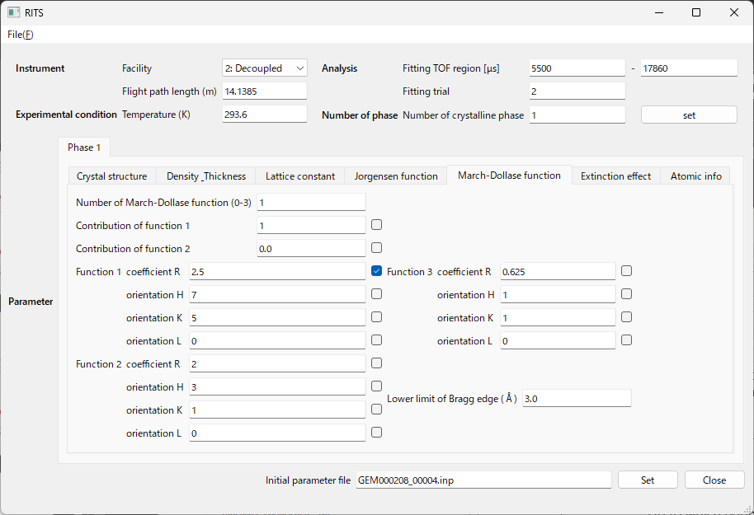
0 is no preferred orientation correction, 1 is Function 1 only, 2 is Function 1 + Function 2, and 3 is Function 1 + Function 2 + Function 3.
Only Function 1 is refined. The preferred orientation vector is 750.
Up to which edge-wavelength is the intensity correction for preferred orientation?
“March-Dollase function ” Tab

Slide 11
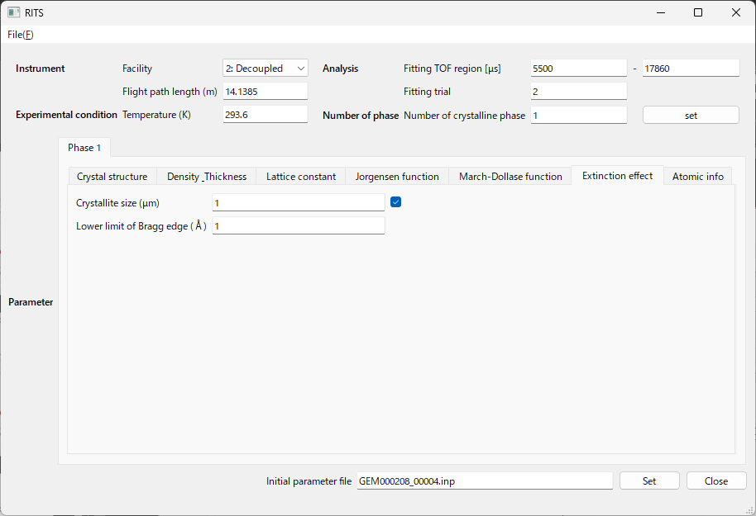

Initial value of crystallite size and refinement flag (initially it may be 0 and off).
Up to which edge-wavelength is the intensity correction for crystallite size?
“Extinction effect ” Tab

Slide 12
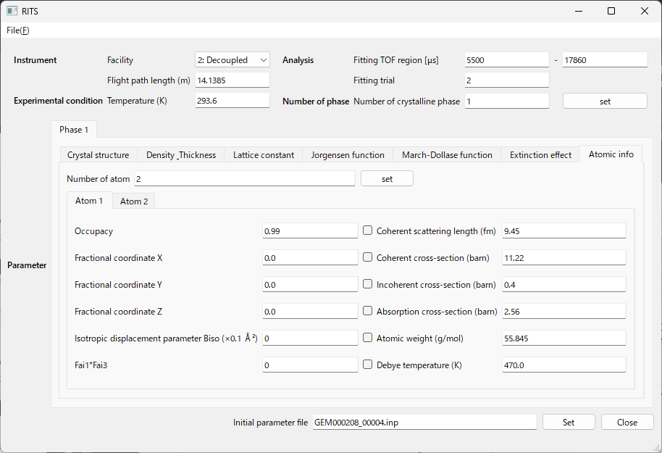

The number of different types of atoms in the unit cell.
To be referred from an international table, or other source.
To be referred from literature, web, etc.
Parameters used for crystal structure analysis.
The refinement flag can be turned on, but is usually turned off.
Thermal vibration parameters and inelastic parameters, which are automatically calculated from temperature and sigma if 0 is entered.
“Atomic info ” Tab

Slide 13
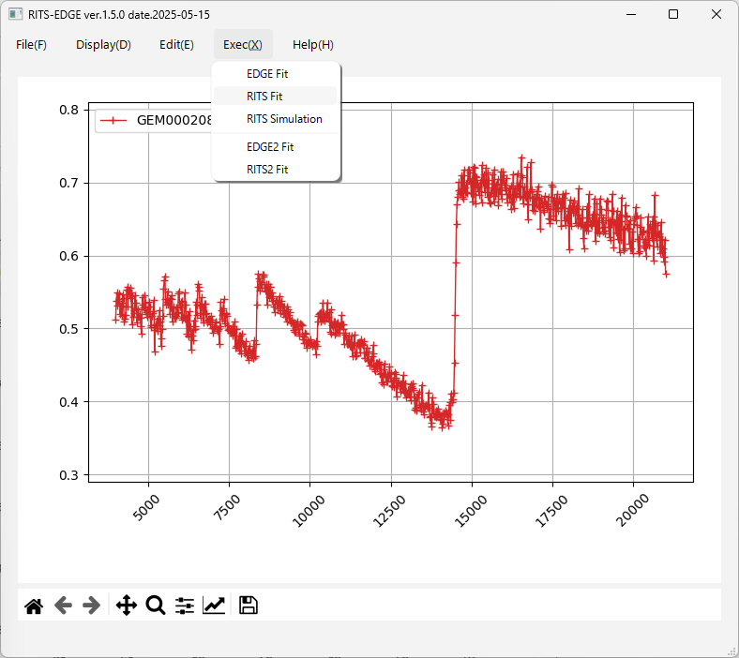

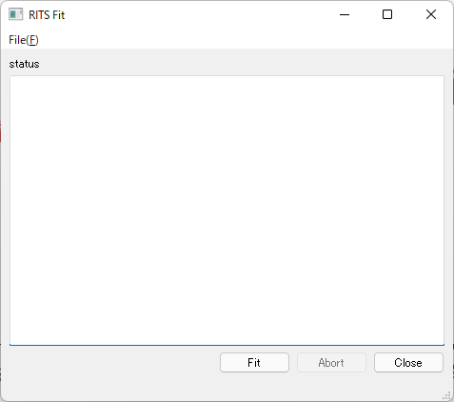
Select RITS Fit from the Exec(X) menu on the main screen, and the RITS Fit panel will appear.
If you did not forget to press the "Set" button on the RITS panel, press the "Fit" button on the RITS Fit panel.
①
②
Set, and Fit
③

Slide 14

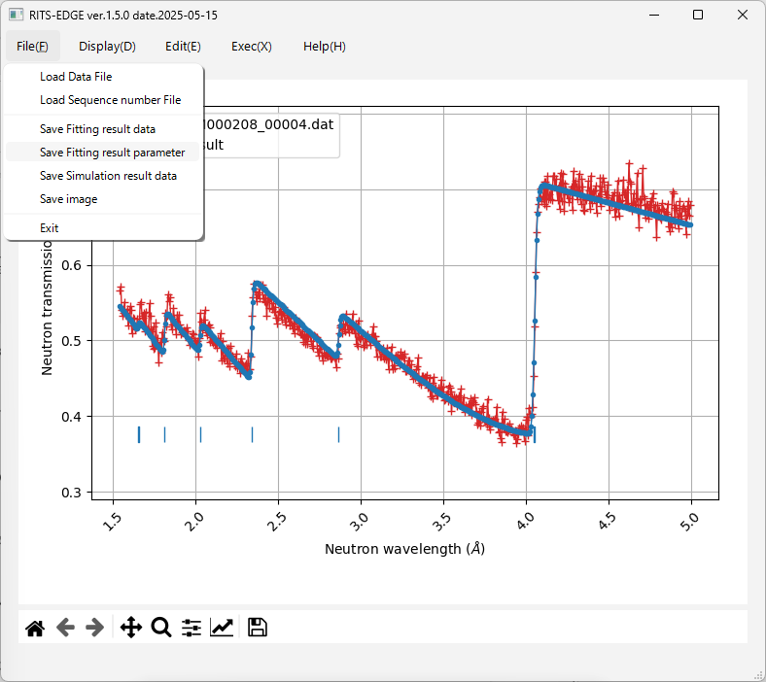
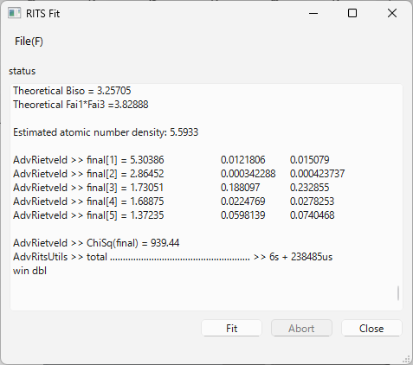
If this is selected, fitting data can be saved as text.
If you select this, you can save the main screen as a PNG file.
  The analysis is completed in 10 or so seconds, and the analysis results appear in the RITS Fit panel.
  Select "Save Fitting result parameter" from the File(F) menu on the main screen to open the Windows Explorer window, and save the result parameters with an appropriate file name.
The RITS initial value file is also saved from "Save initial Parameter" in the File menu of the panel.
Note that the initial file is not automatically updated.
Calculated Thermal vibration and inelastic parameters.
χ²

Slide 15

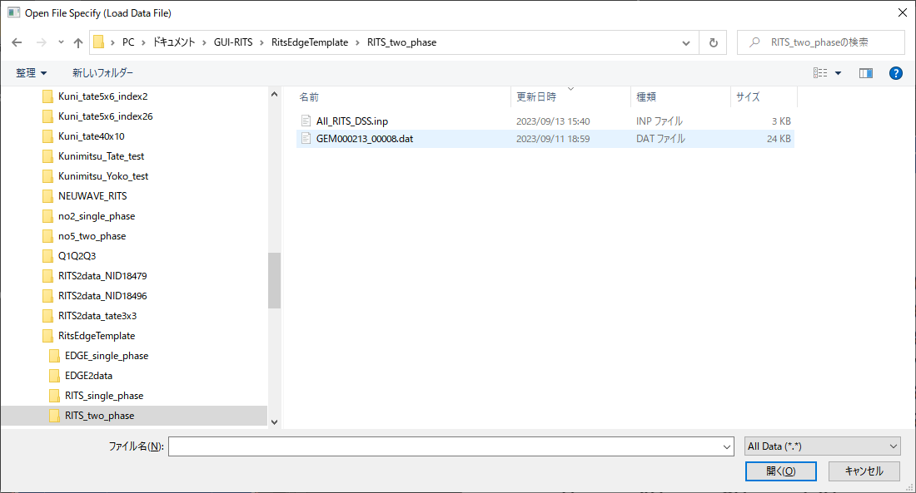
Next, let's load a transmission data from the template folder ‘RITS_two_phase’.
Select "Load Data File" from the File menu.
The Windows Explorer screen will appear, and select the data file ‘GEM000213_00008.dat’.

Slide 16
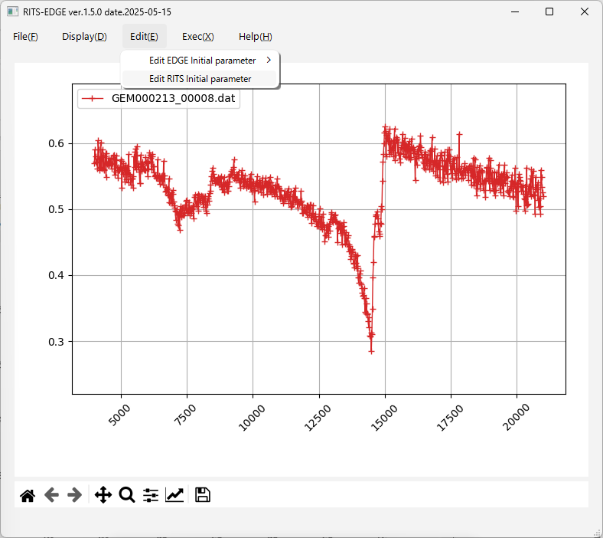
After loading the data file for a sample (in this example, GEM000213_00008.dat), the spectrum is displayed as shown in the main screen. The horizontal axis is tof (μs) and the vertical axis is transmittance.
The explanation of the Display(D) menu is omitted.
Next, select Edit RITS Initial parameter from the Edit menu.

Slide 17
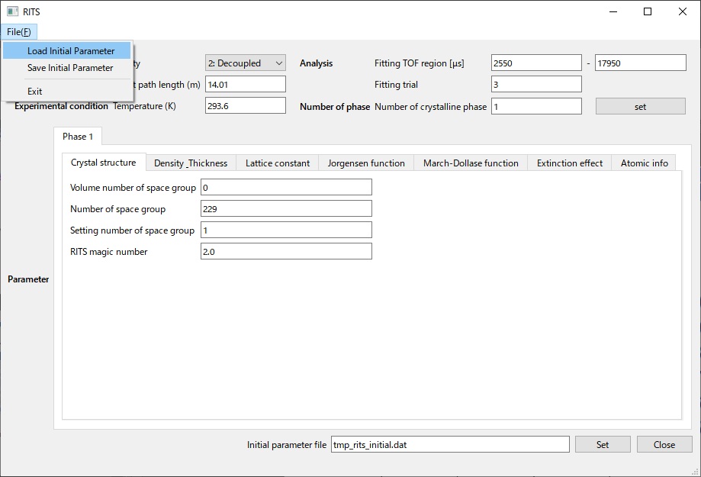
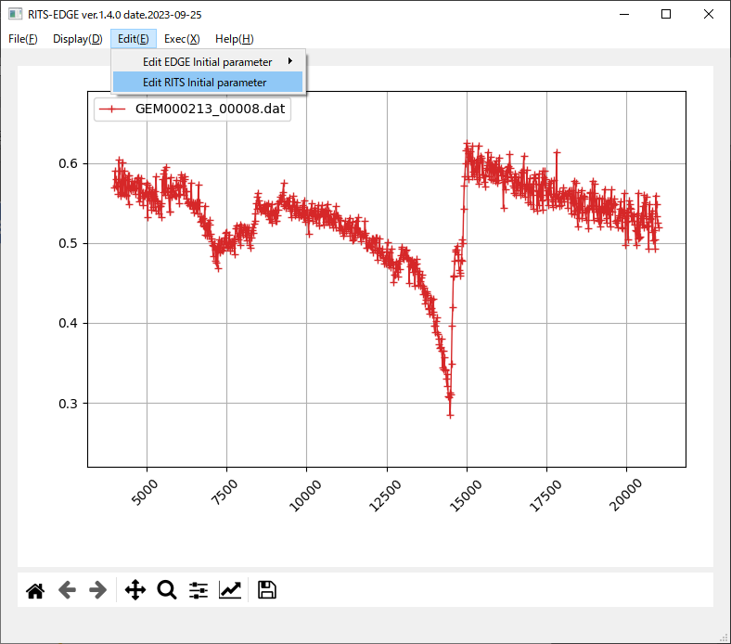
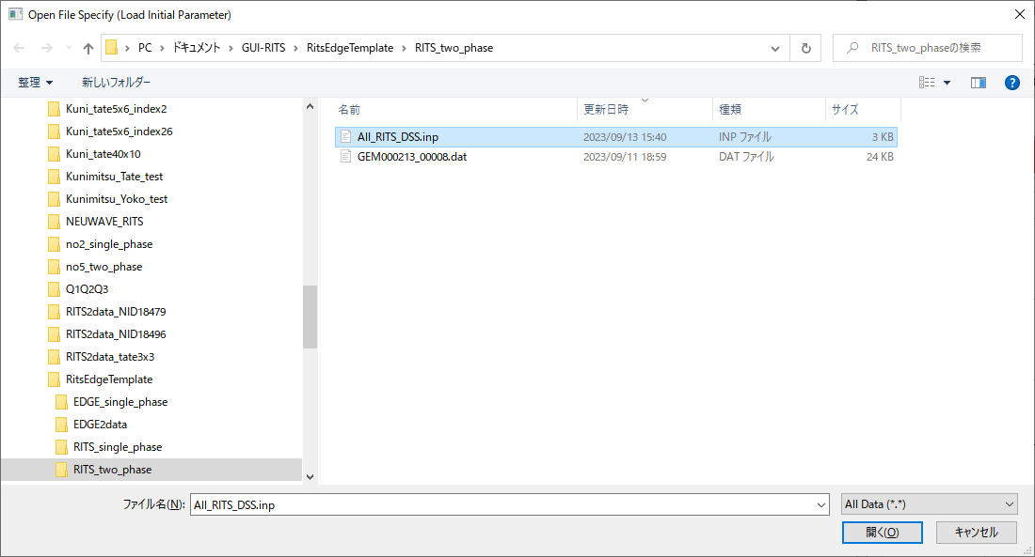
By selecting "Load Initial Parameter" from the File menu of the RITS panel, the Windows Explorer screen will appear.
Select the initial value file to read the values. (ex. All_RITS_DSS.inp)

Slide 18
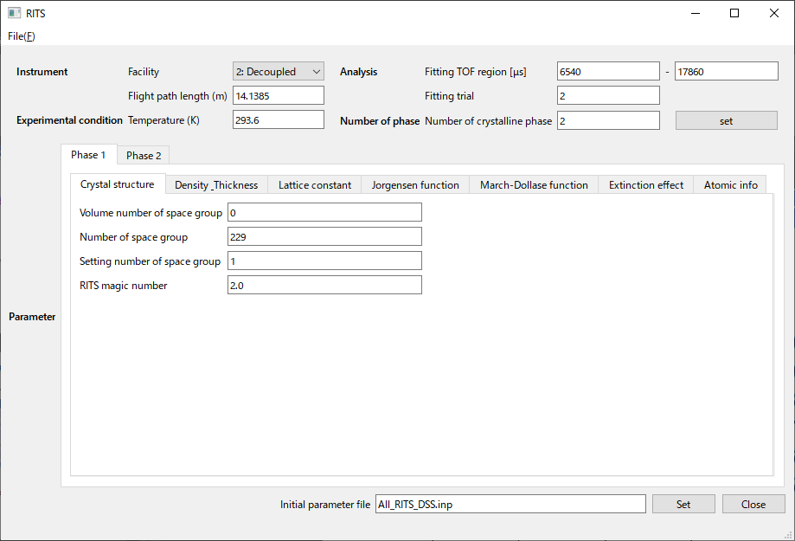
Analysis range.
I think more would only take more time.
1 for single phase, 2 for 2 phase.
Leave it 0.
Space group number
Space group setting
Number of formula units (molecules) in the unit cell; Z-value
Select tab for Phase 1 or 2
When the initial value file is read (All_RITS_DSS.inp in this example), the values and the flags are entered.
“Crystal structure” Tab

Slide 19
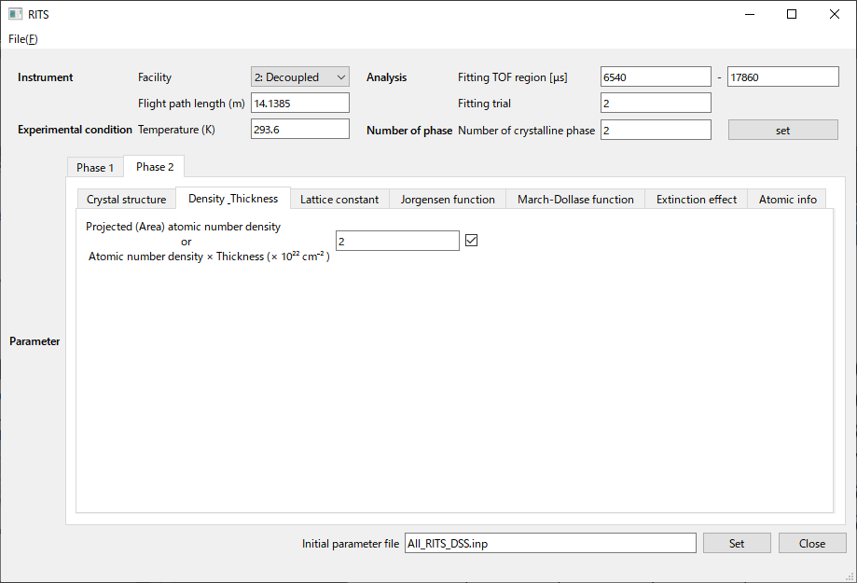
refinement flag
Automatic estimation' is not available for two-phase analysis.
“Density_Thickness” Tab

Slide 20
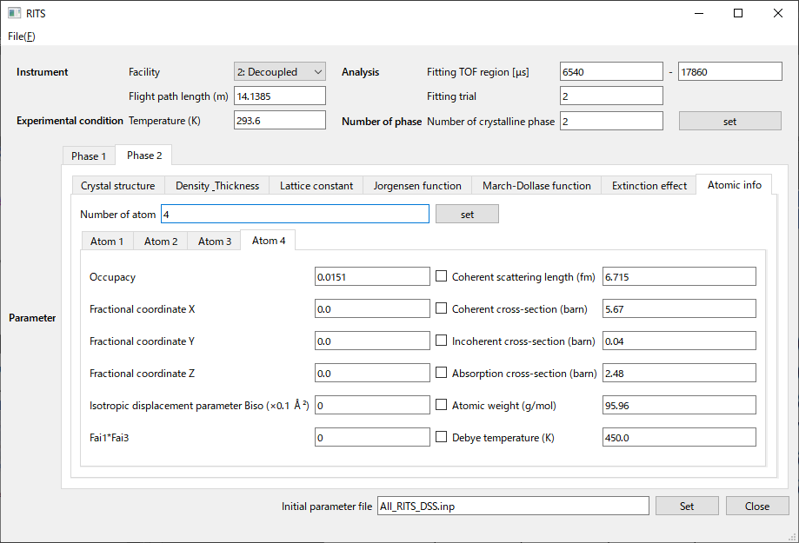
The number of different types of atoms in the unit cell.
To be referred from an international table, or other source.
To be referred from literature, web, etc.
Parameters used for crystal structure analysis.
The refinement flag can be turned on, but is usually turned off.
Thermal vibration parameters and inelastic parameters, which are automatically calculated from temperature and sigma if 0 is entered.
“Atomic info ” Tab

Slide 21
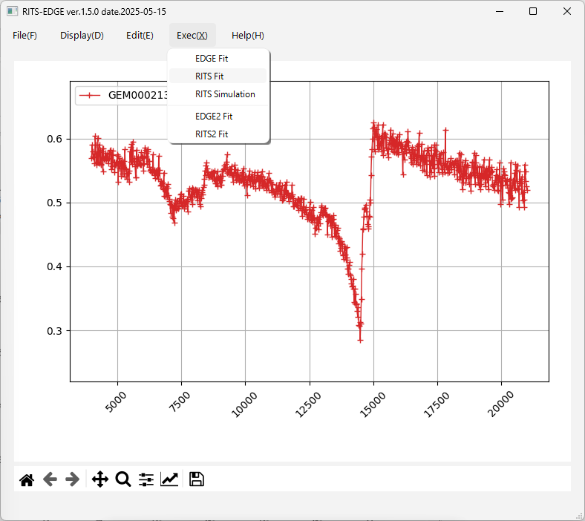
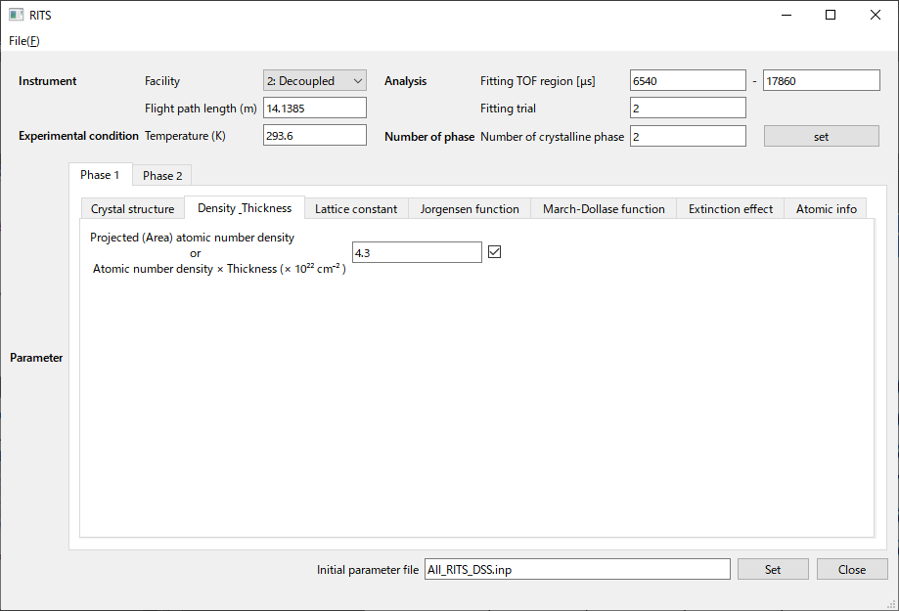
Select RITS Fit from the Exec(X) menu on the main screen, and the RITS Fit panel will appear.
If you did not forget to press the "Set" button on the RITS panel, press the "Fit" button on the RITS Fit panel.
①
②
Set, and Fit
③

Slide 22
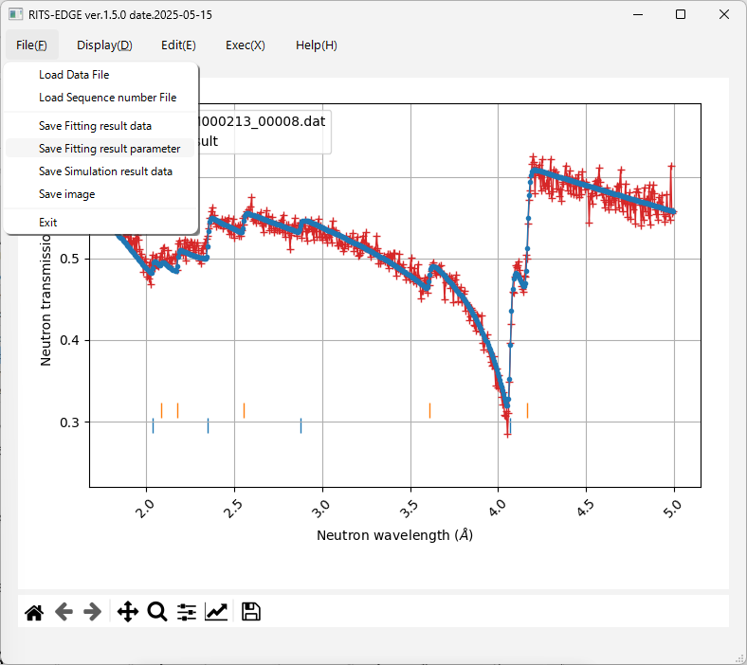
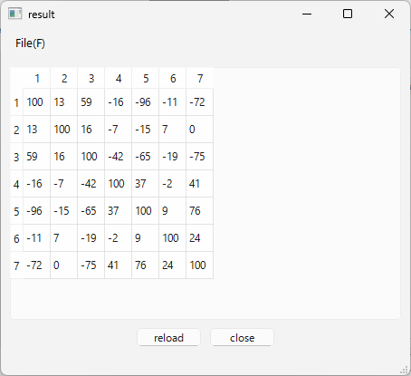
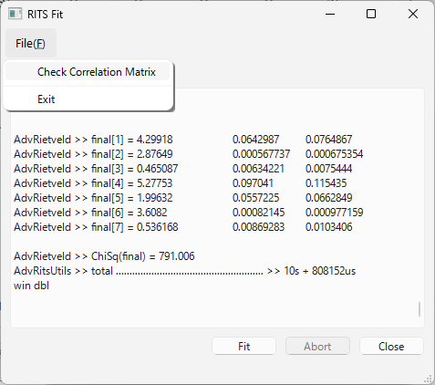
standard deviation = (covariance matrix)^{0.5}
You can check correlation matrix.
C×standard deviation
C = (χ² ∕ (n − p))^{0.5}
The RITS initial value file is also saved from "Save initial Parameter" in the File menu of the panel.
Note that the initial file is not automatically updated.
χ²

Slide 23
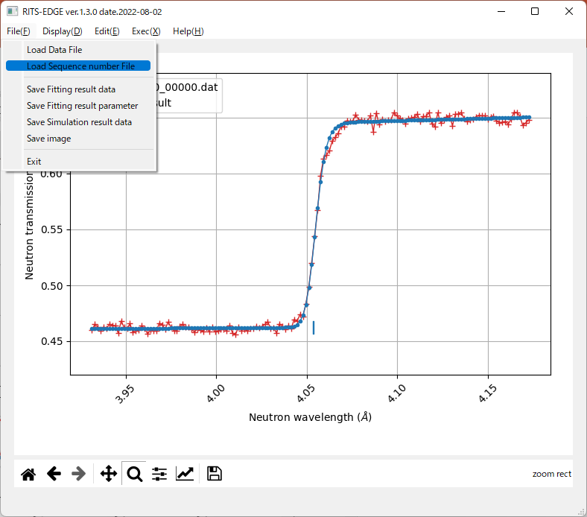
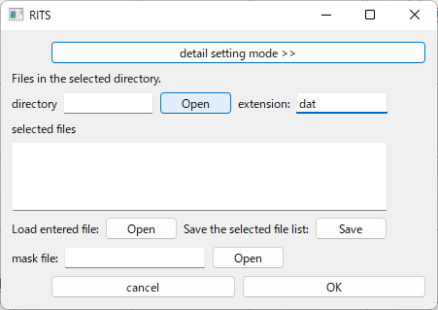
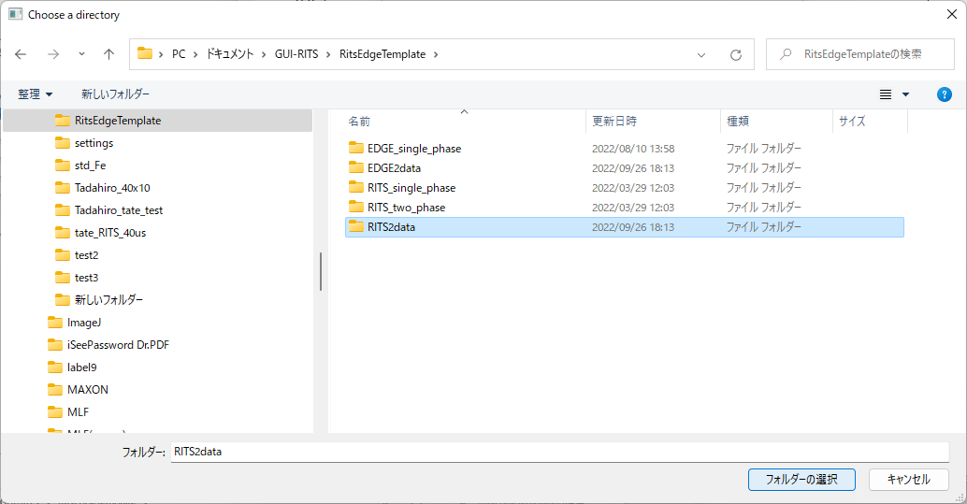
Next, how to use RITS2 program. let’s select a data folder that contains sequence number file of the transmission data.
Select "Load Sequence number File" from the File menu.
The Windows Explorer screen will appear, and select the folder (in this example, RITS2data) with a extension: dat.

Slide 24
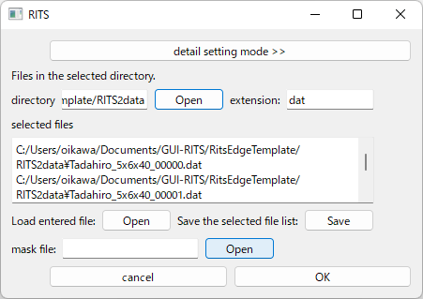
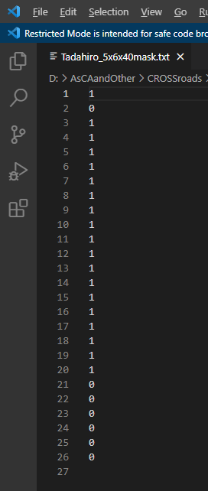
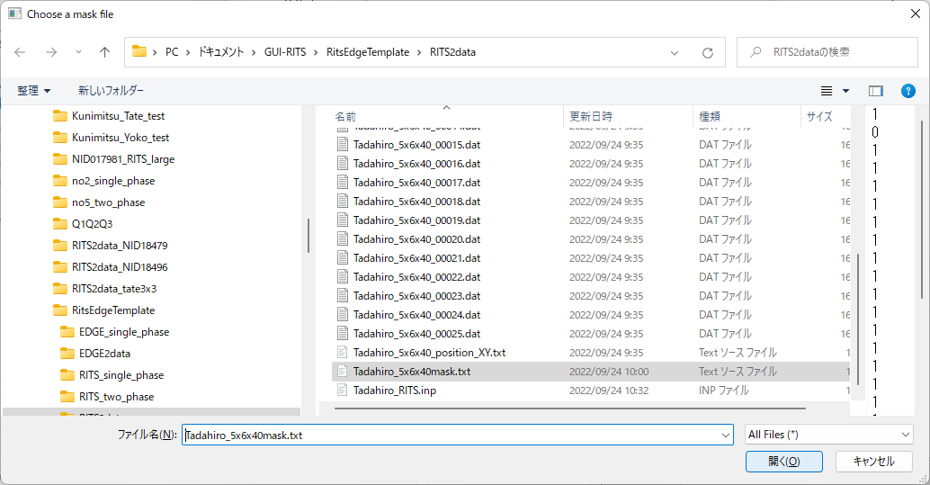
Next, select the mask file.
Select "Tadahiro_5x6x40mask.txt" in the “RITS2data" folder.
Some data are masked in this example.

Slide 25
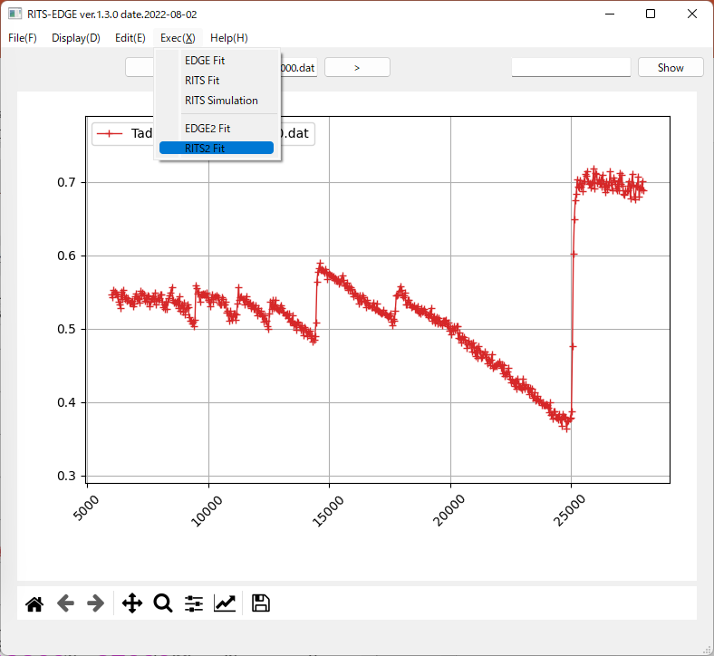
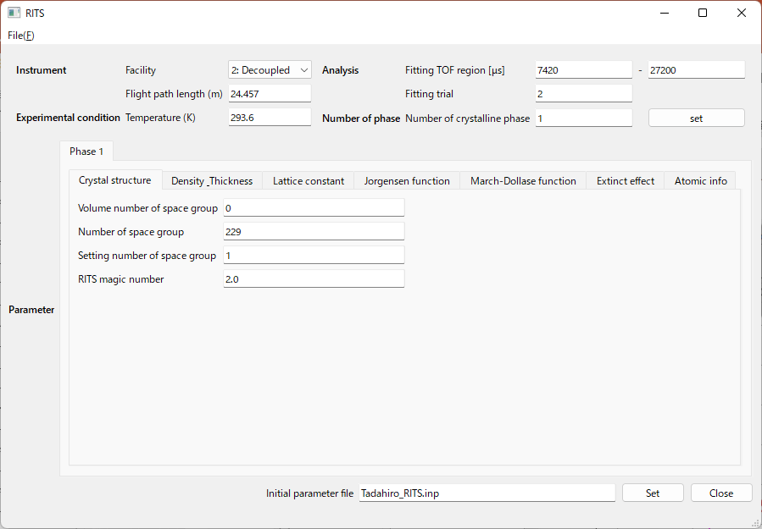
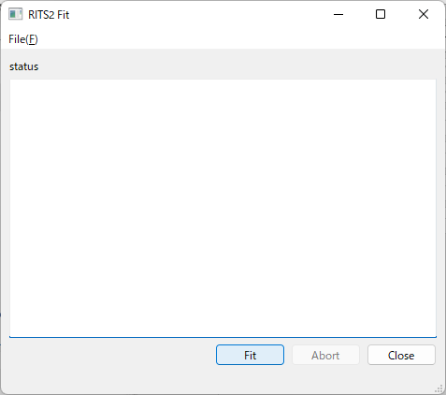
By selecting "Load Initial Parameter" from the File menu of the RITS panel, the Windows Explorer screen will appear. Select “Tadahiro_RITS.inp” from the “RITS2data” folder.
①
Select RITS2 Fit from the Exec(X) menu on the main screen, and the RITS2 Fit panel will appear.
If you did not forget to press the "Set" button on the EDGE panel, press the "Fit" button on the EDGE Fit panel.
②
Set, and Fit
③

Slide 26
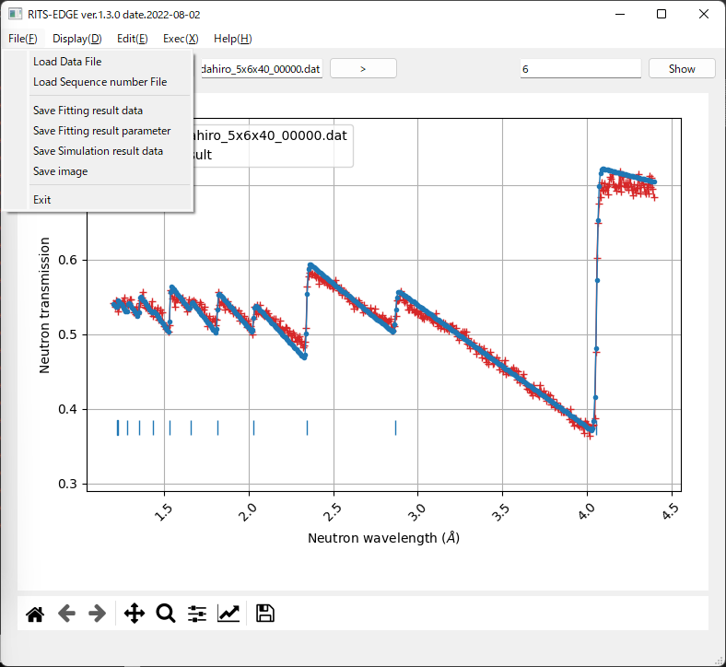
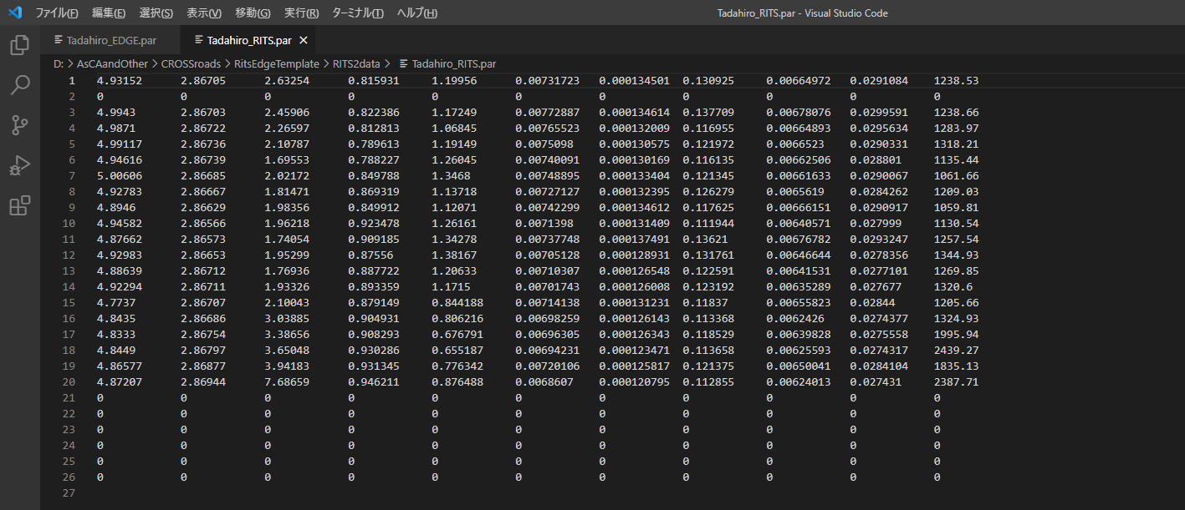
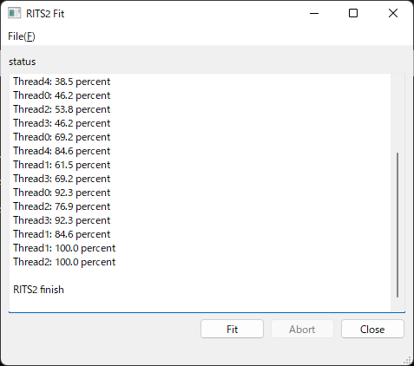
If you select “Save Fitting result data”, you can save the displayed fitting data as text.
The calculation results can be saved with an appropriate file name by selecting "Save Fitting result parameter" in the File menu on the main screen, which will bring up the Windows Explorer screen.
Example of Result parameter
masked
The progress of the calculation will be displayed.
masked
σt, a, sigma1, r, s, σt_err, a_err, sigma1_err, r_err, s_err, χ²

Slide 27
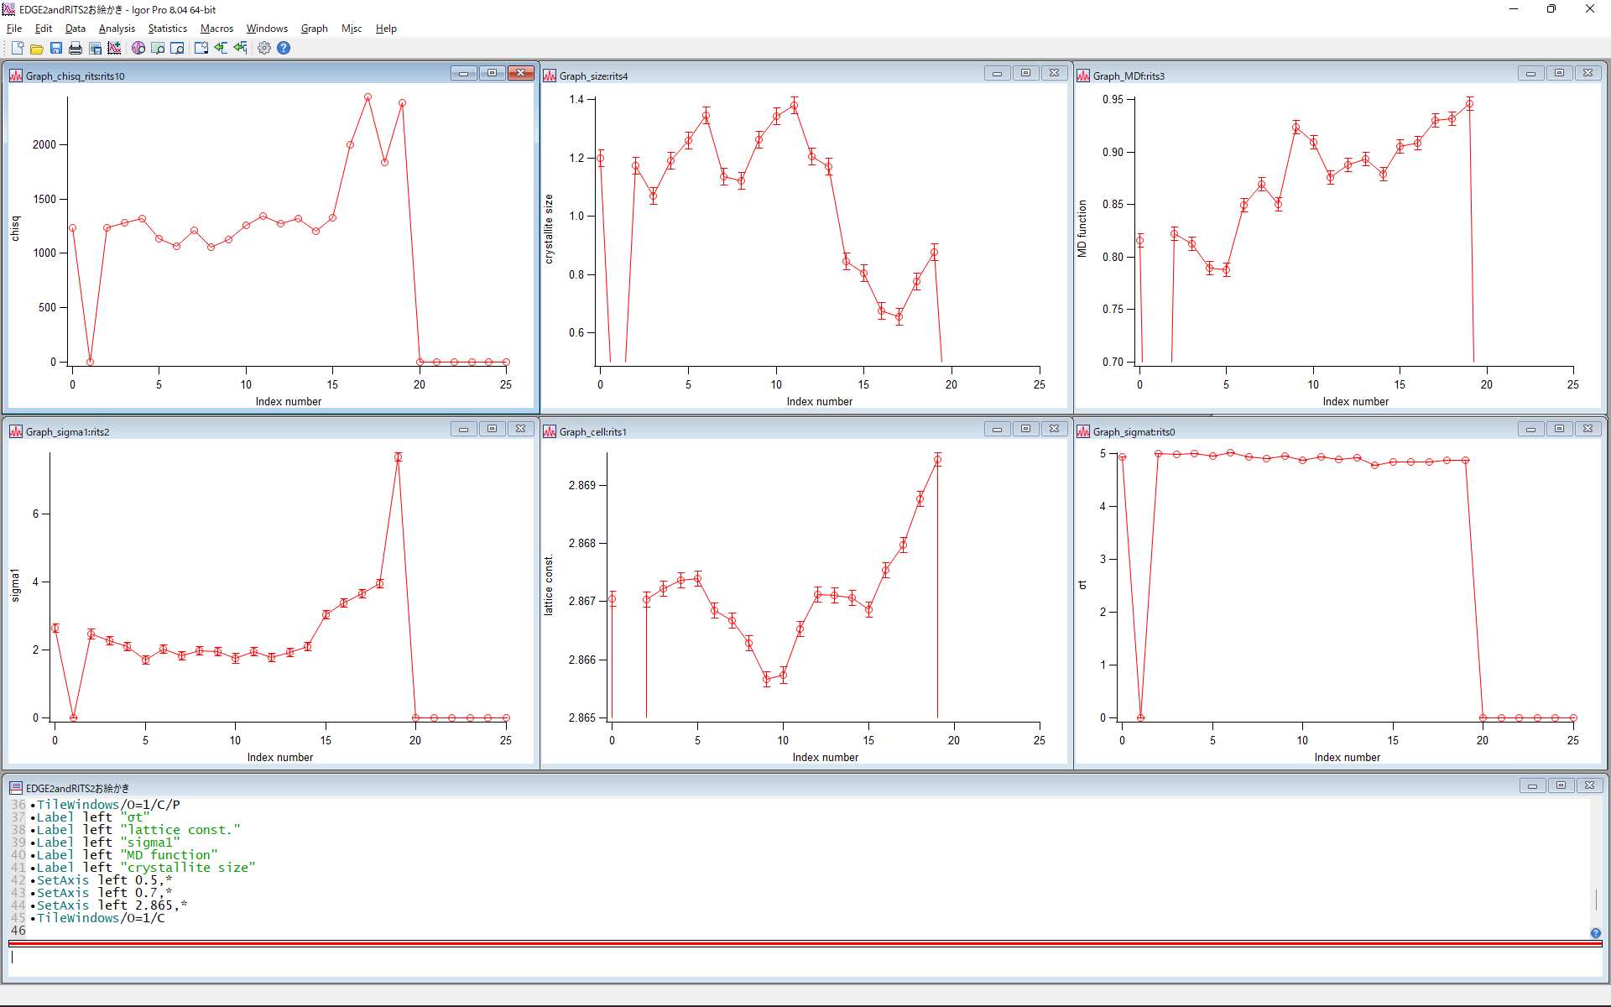
χ²
s
r
sigma1
a
ρt
Plot the Result parameter in Igor Pro.

